Slide 1
Mobile HAM Radio Install
Brian O’Neill K6DWD

Slide 2
Agenda
Radio Selection
Wiring Considerations
Connectors, Cabling, Hardware, and Tools
Radio Install
Antenna Selection and Installation
Speaker selection and Location
Final Thoughts

Slide 3
Radio Selection
My Checklist:
  Large display
  Head unit separate from body
  Lots of memory channels
  Dual VFO
  Digital Mode

Slide 4
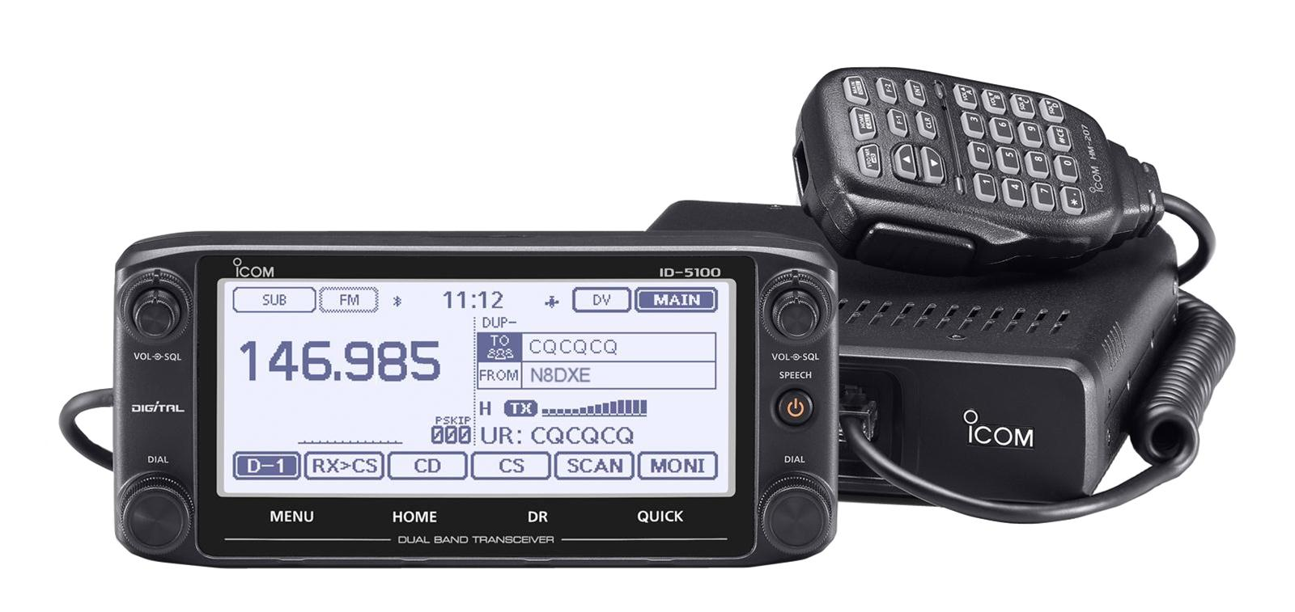
Icom ID-5100A
Notes:
Touchscreen has held up well. No issues.
Dual VFO has been very useful
Quick Menu is handy when driving
Auto dimming feature is nice. Time and brightness programmable with this
Auto shut-off is nice. Programmable (I set to 90 minutes).
Like the GPS function that finds repeaters when you are traveling
Wiring considerations next..

Slide 5
Wiring and Battery Considerations

Slide 6
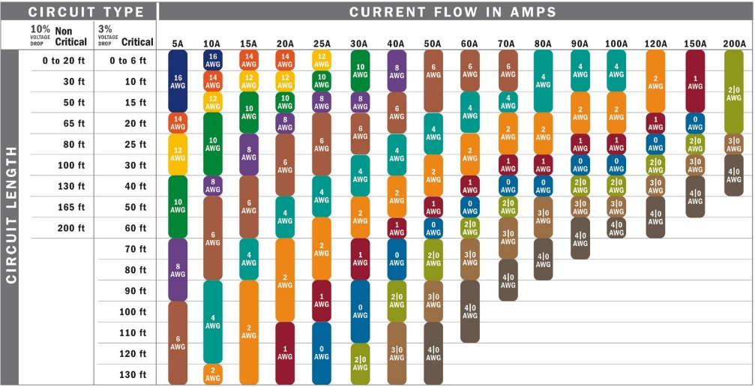
Wire Gage vs Run Selection Guide
What is the Radio Peak Current Draw?
How Long is the Wire Run?
Notes:
ID-5100 is fused at 20 amps. Wire run is between 15 and 20 feet. Typical peak current for 50 Watt radio is around 11 amps.

Slide 7
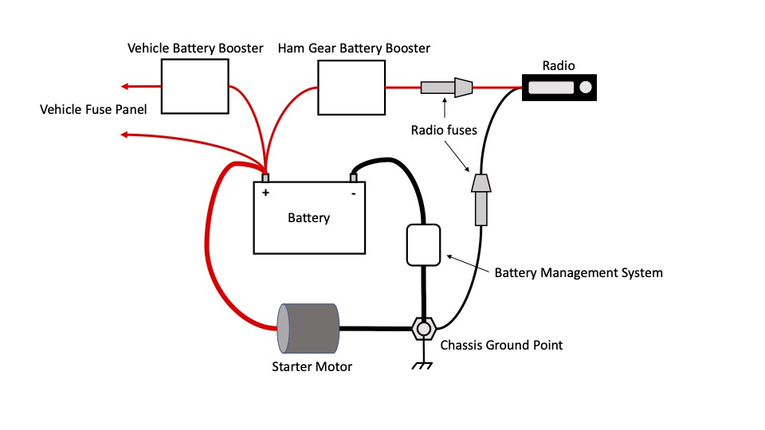
Battery Connection
Notes:
Hot lead from Radio goes direct to battery.
Negative lead goes to chassis ground point of Battery
DO NOT bypass the battery management system by running the radio negative lead direct to battery negative.

Slide 8
Connectors, Cabling, Hardware, and Tools

Slide 9
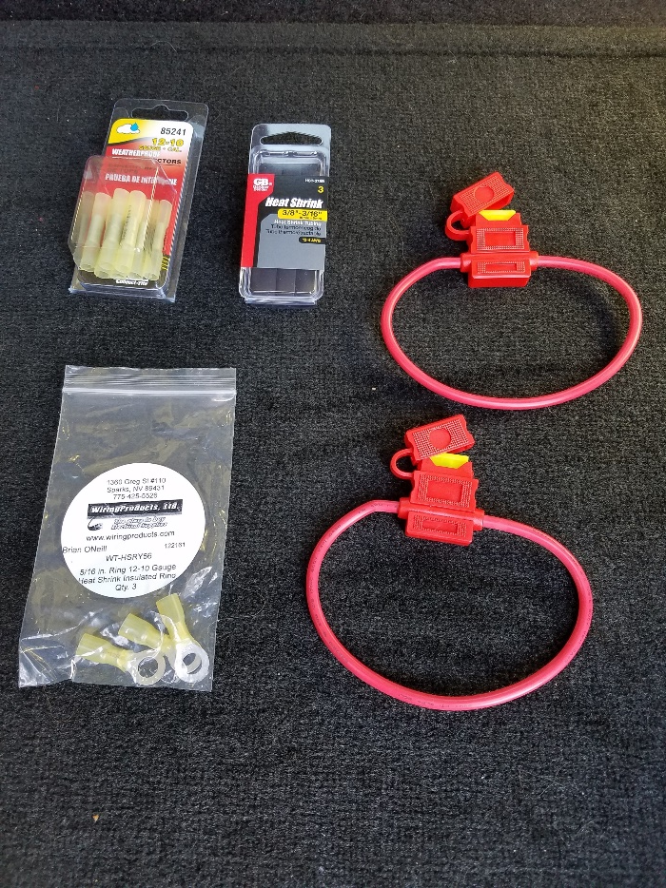
Wiring Hardware
Crimp Connectors
Heat Shrink Tubing
Ring Terminals
In-line Fusing
Notes:
Packaged parts readily available locally
In-Line Fusing parts available from on-line sources

Slide 10
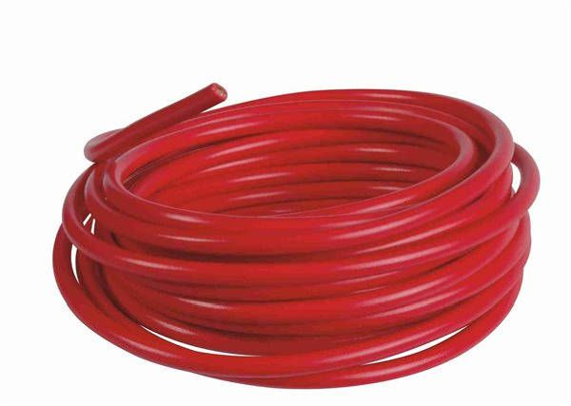
10 Gauge Red and Black Primary Wire
$18.47
Red 10 Gauge Primary Wire P/N W-10P-RE
25 Feet
Wiringproducts.com
Notes:
Same detail for black wire (also purchased)
American made.

Slide 11
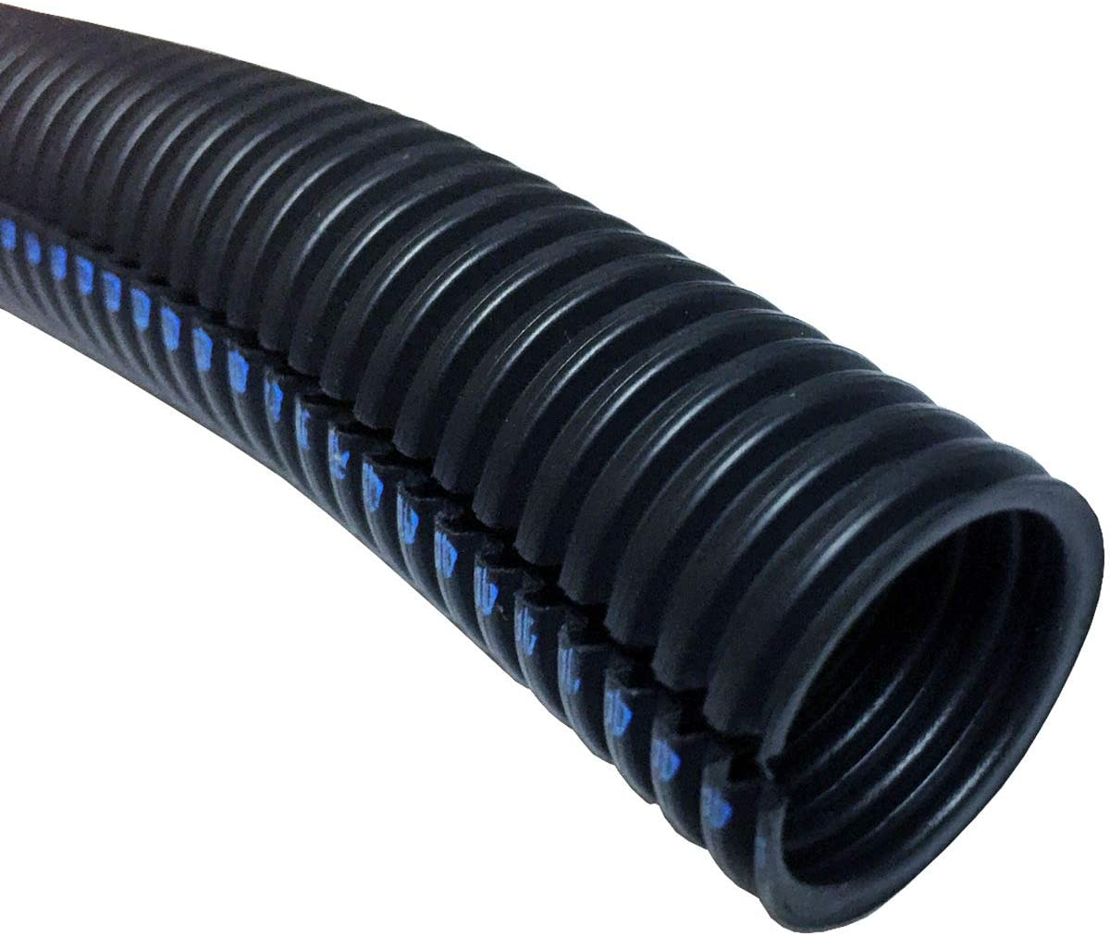
3/8” Split Loom
$11.90
Electriduct P/N WLFR-0375-10
10 Feet
Amazon
Notes:
Used to harness the radio battery wires in the engine compartment

Slide 12
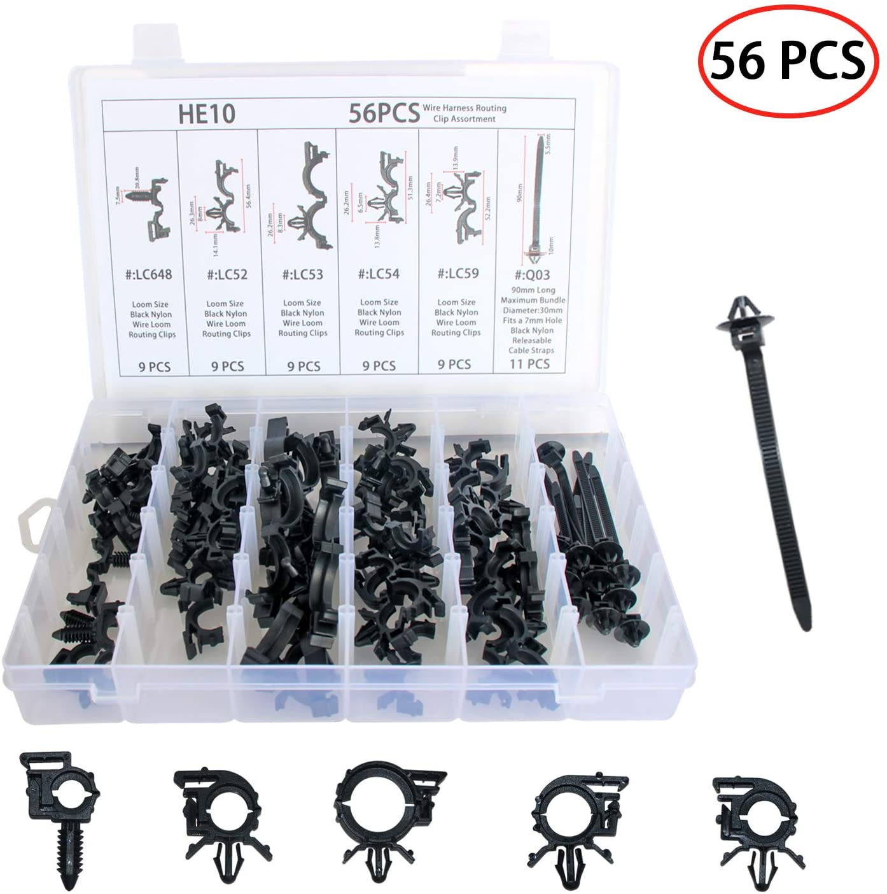
Wire Harness Routing Clips
$15.99
Rolinger P/N SDQ56PCSKK
Amazon
  Used to route the wire loom
  Requires small holes to be drilled as needed
Notes:
Used (as needed) where there is no good place to tie-wrap and secure the wire loom harness out of the way.

Slide 13
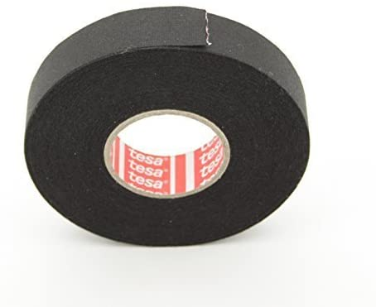
Engine Compartment Wiring Tape
$6.99
Tesa P/N CECOMINOD030404
Amazon
Notes:
Automotive professional quality. No issues after more than a year in service.
Used to transition radio power wires from the firewall to the wire loom.
Used to transition end terminals from the wire loom to the battery and ground point.

Slide 14
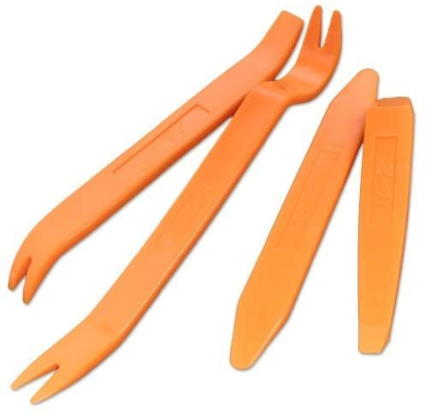
Panel Trim Removal Tools
$6.99
KLTECH P/N CAR-1
Amazon
Notes:
Very useful.
Quickly pops loose various plastic body panels in preparation for running wiring / cabling.
No issues with damaging body panels.

Slide 15
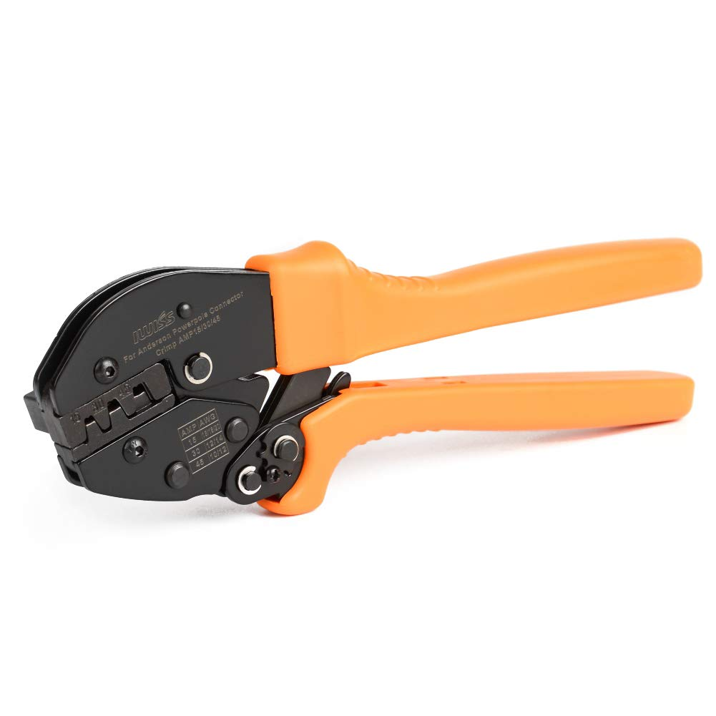
Powerpole Crimp Tool
$29.99
IWISS Model AP-153045
15, 30, and 45 amp connectors
Amazon
Notes:
If you do any Anderson Powerpole DIY connections, you need these..

Slide 16
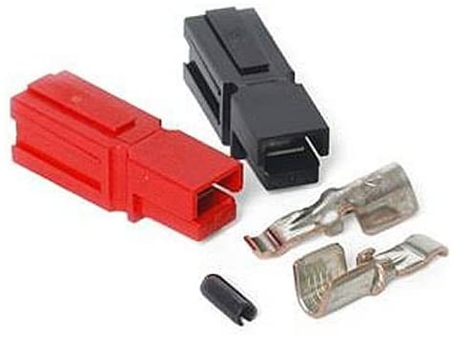
Powerpole Connectors
$22.49
Anerson Powerpole P/N PP45-10
45 Amp
10 sets with roll pins
Amazon
Notes:
Using these at the radio side, not in the engine compartment

Slide 17
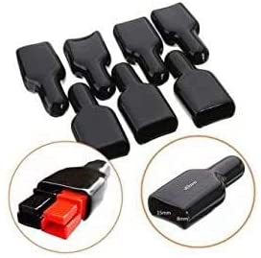
Powerpole Covers
$7.99
Brccee AC P/N 854175854
Amazon
Notes:
Used to temporarily cap-off terminals when radio or accessories are removed.
Not a requirement, but adds an extra measure of safety against damage / shorts.

Slide 18

3M Adhesive Back Hooks
$2.40
3M Command Brand Wire Hook Medium
Walmart
Notes:
Used as a Mic. hanger

Slide 19
Extending Cabling from Radio to Control Head and Microphone

Slide 20
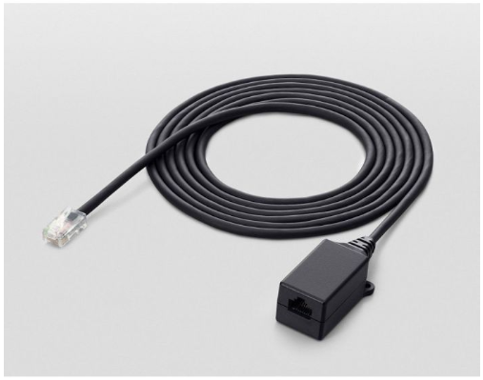
Icom Microphone Extention Cable
Icom OPC-440
$74.49 / GigaParts.com
Or..
Notes:
The official Icom part.
There’s a better / cheaper way..

Slide 21
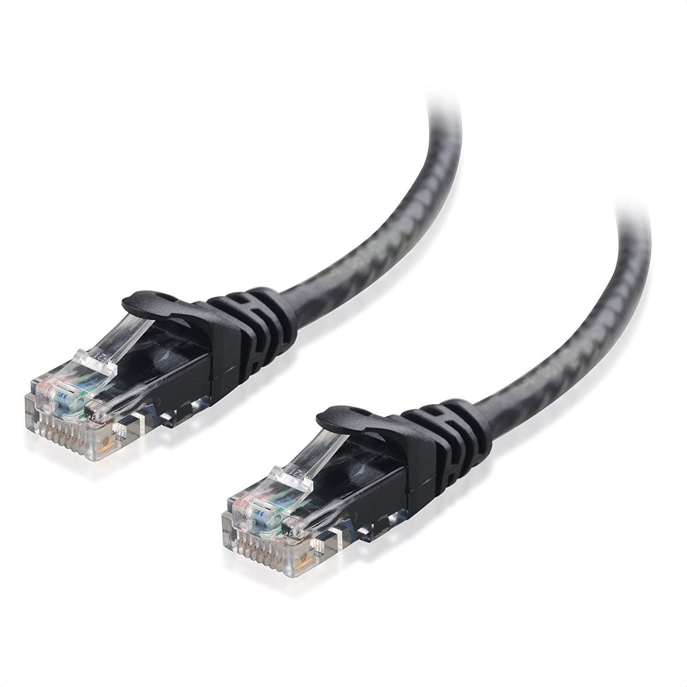
20 ft. Ethernet Cable
$8.99
Cable Matters Cat6
Amazon.com

Slide 22
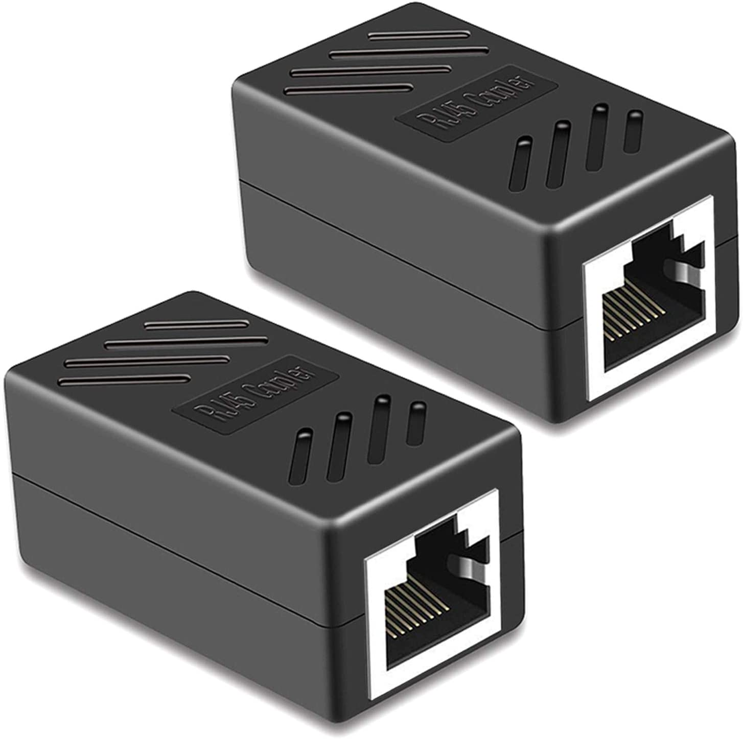
RJ45 Couplers
$6.88
PLUSPOE P/N CCA001A
Amazon
Notes:
Used this initially.
Worked fine, but did not like the look.
Potential (for my install) for RJ45 cable damage

Slide 23
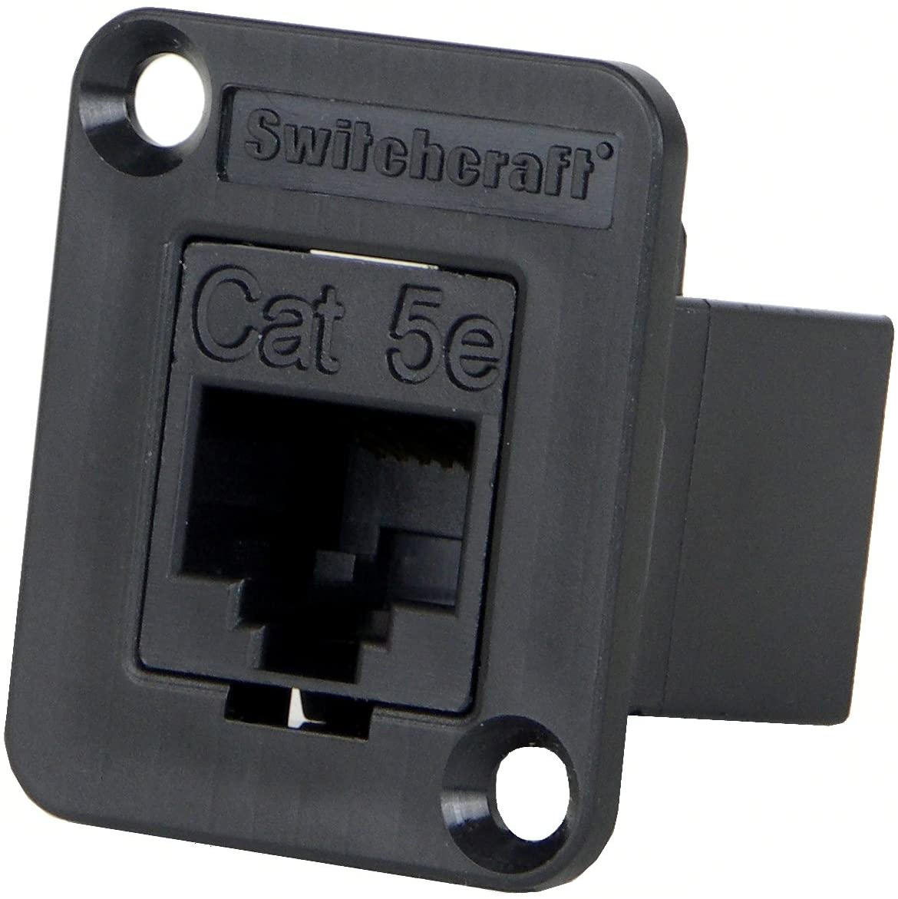
RJ45 CAT5e Panel Mount
$16 Amazon
Switchcraft P/N EHRJ45P5E RJ45
Machine Screws, washers, nuts purchased separately (Home Depot)
Panel Mount + Cable + Hardware = More than $40 savings vs Icom cable!
Notes:
Ultimate solution was to use this panel mount.
Clean professional look.
Attaches to a removable body panel via small machine screws.

Slide 24
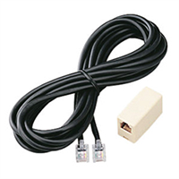
Icom Front Panel Extension Cable
Icom OPC-1156
$30 / GPSCentral.ca
Or..
Notes:
The official Icom head unit extension cable.
There is a better and cheaper way here too..

Slide 25
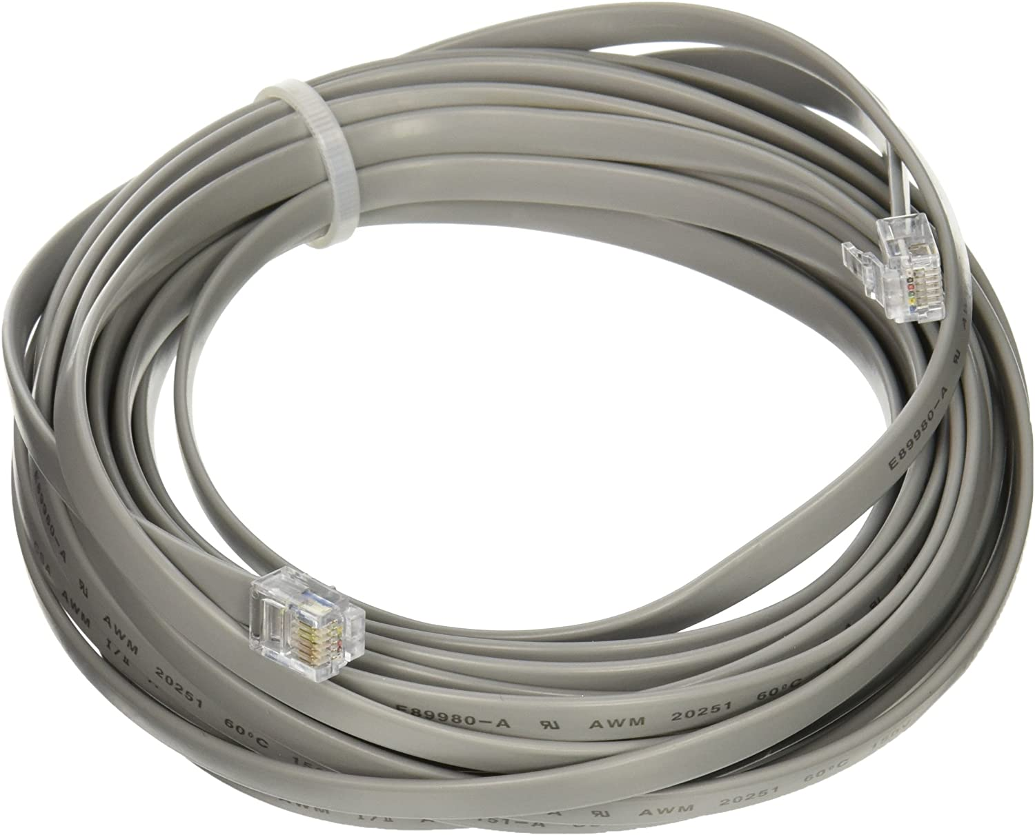
25ft. RJ12 Cable
$6.46
Cables To Go P/N 08114 RJ 12 6P6C
Amazon
Notes:
Straight through cable matches that of the Icom.
No coupler involved. Order the length you need and go end-to-end with one cable.

Slide 26
Installation Process

Slide 27
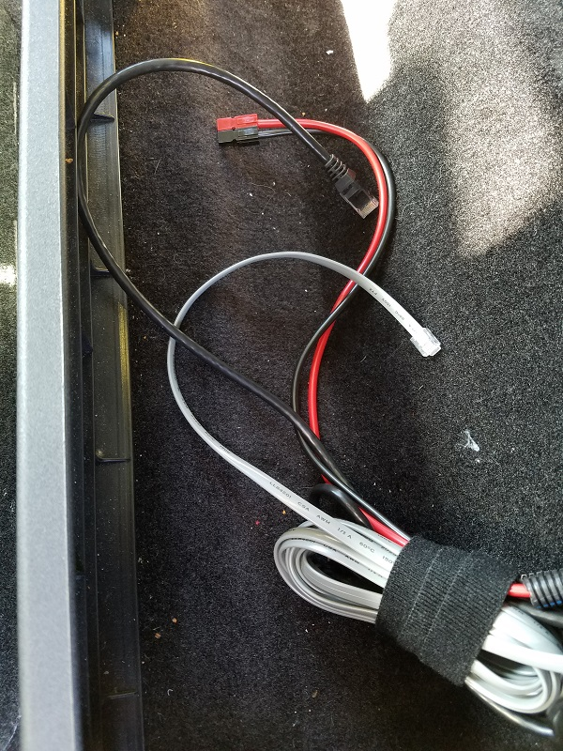
Start Run from Radio Location
Radio will be located at rear.
Power, Microphone, Control cables will be run under floor panels to the front.
Rear seat folds down at this location to hide everything.
Notes:
Leave extra cabling for any changes
Rear seat (not shown) folds down to hide installation

Slide 28
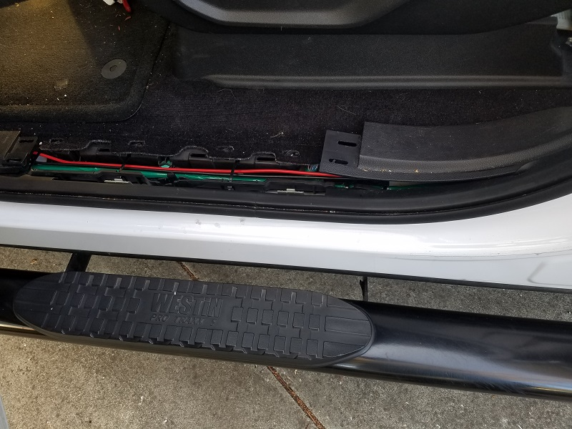
Run Wiring under Floor Panels
Fairly easy to run with the floor trim removed.

Slide 29
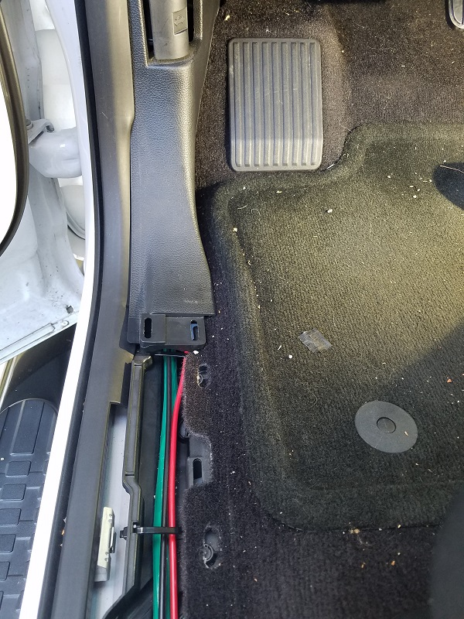
Run Wiring under Floor Panels
Wires and cables will run vertically through this panel and exit out where dash panel meets.
Power wires will split out to the engine compartment.
Microphone and Control cables will route along bottom of dash panel then split off to their locations.

Slide 30
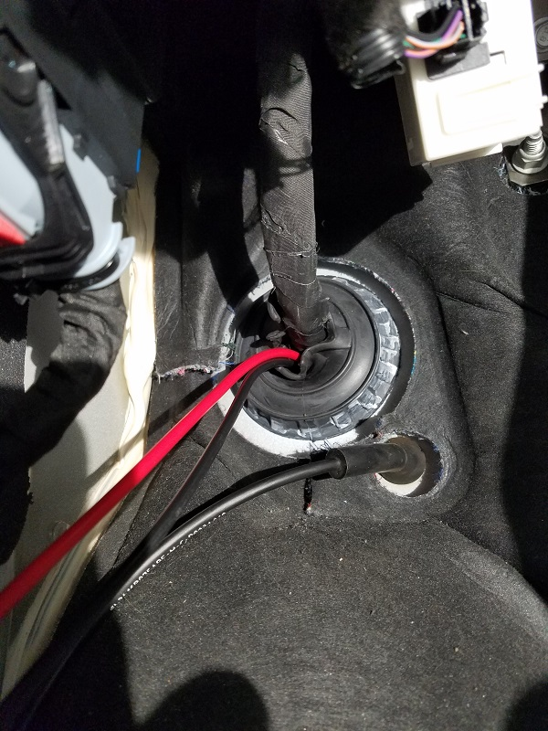
Battery Wiring
Run power wires to engine compartment
If possible, use an existing pass-through grommet to run wires to battery.
A stiff wire (not shown) was shaped and used to pull wires from interior through to engine compartment.
Notes:
Place a small hook in the interior side of the coat hanger wire
Attach the wiring and wrap with electrical tape avoiding any bulging
Pull wiring from the engine side through to the battery location
Leave plenty of extra for dressing and trimming

Slide 31
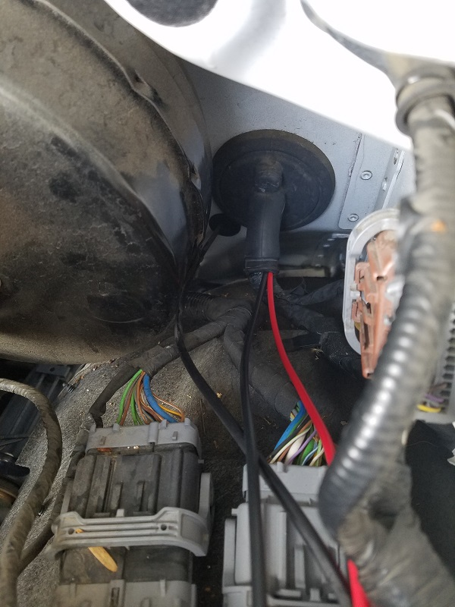
Battery Wiring
Pull wires from engine side to battery location
Weather seal tie wrap around grommet was removed to allow power wires to pass through to engine compartment.
Notes:
This grommet was large enough to easily accommodate the two 10 gage power wires

Slide 32
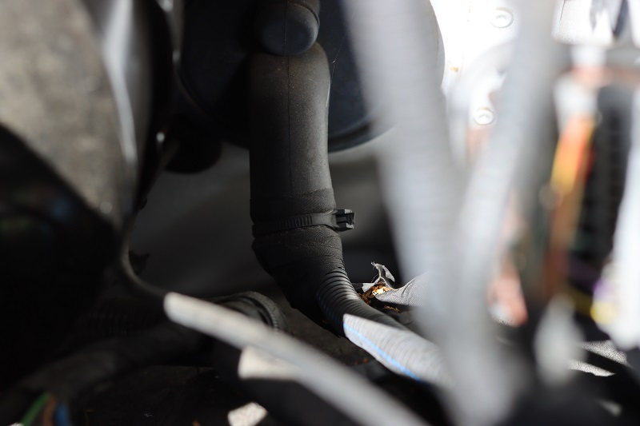
Battery Wiring
Secure and seal wires at pass-through grommet
Attach split-loom over wires.
Use the automotive tape to seal around the grommet.
Attach a new tie wrap to secure everything.

Slide 33
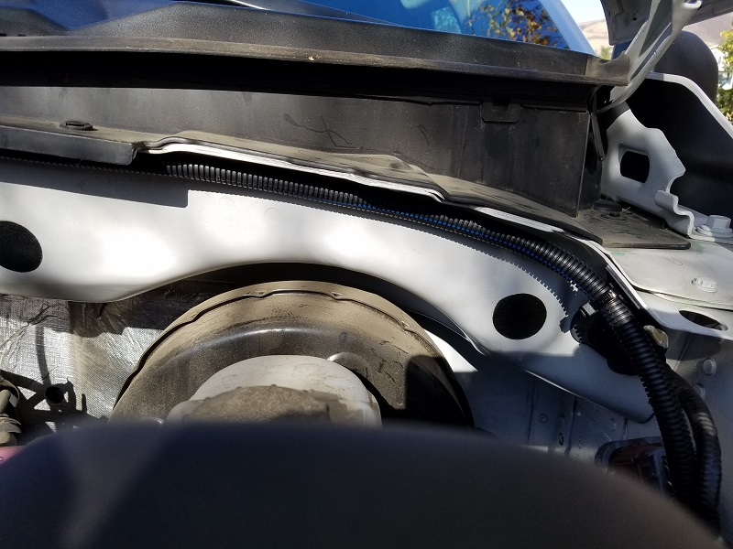
Battery Wiring
Routed harness along backside of engine compartment.
Battery location is passenger side front.
Notes:
Routing should be the easiest path. Not necessarily the shortest
Routing should not interfere with any service or maintenance work

Slide 34
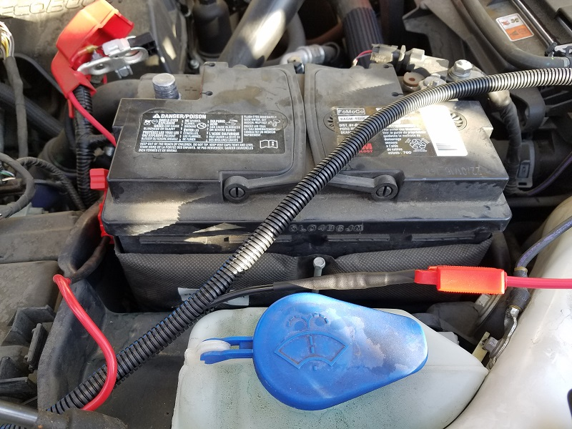
Battery Wiring
At Battery, wires are removed from loom for attachment.
In-line fuses are crimped and secured with heat-shrink tubing.
Notes:
When removing wires from loom at battery, remove enough such that they can be routed to connection points without interfering with battery service.

Slide 35
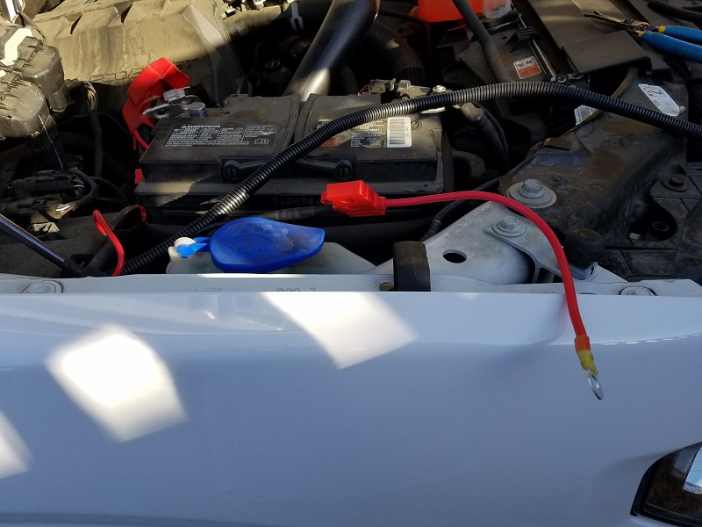
Battery Wiring
Heat-shrink ring terminals attached.
They only came in red! This is the negative terminal.
Notes:
Need to wrap this terminal in black tape for proper color coding.

Slide 36
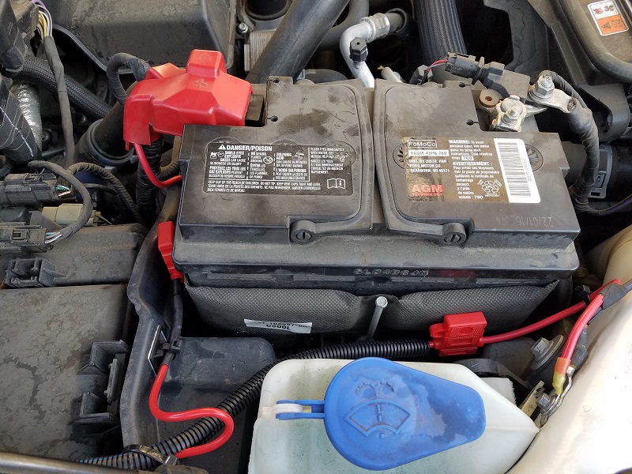
Battery Wiring
Completed Battery Wiring.
Access to battery for servicing has not been altered with this routing.

Slide 37
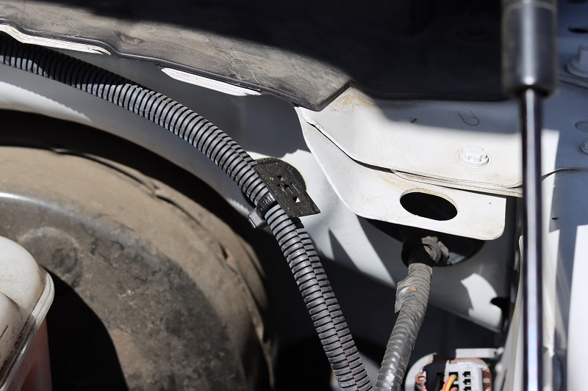
Battery Wiring
Harness Securing / Problem
Self-adhesive tie wrap mounts used initially.
Held for about a year before detaching during summer heat.
Notes:
These were super sticky and secure initially
Used in several locations in favor of not having to drill any holes.
Failed after about a year

Slide 38
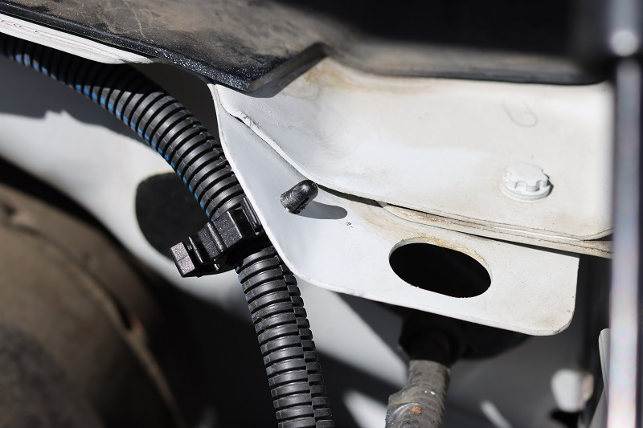
Battery Wiring
Harness Securing / Solution
Wire harness clips used to secure harness.
Requires drilling a small hole to secure the clip.
Notes:
Next we return to the interior to route the cable assemblies and install the connection points.

Slide 39
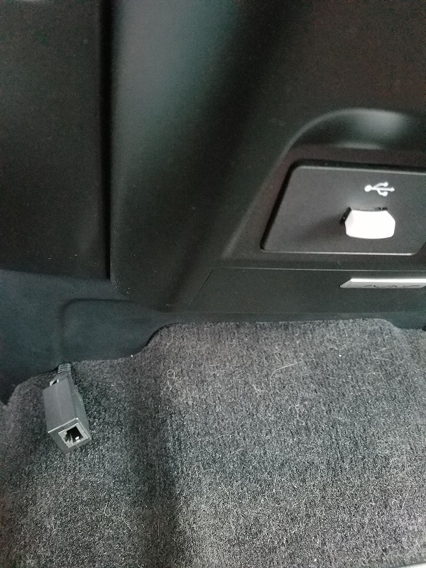
Microphone Connection
RJ45 Coupler
This was the initial idea. Works fine, but not very clean.
Potential for cable to get pinched / damaged over time.
Notes:
This is one of the RJ45 coupler parts shown earlier

Slide 40
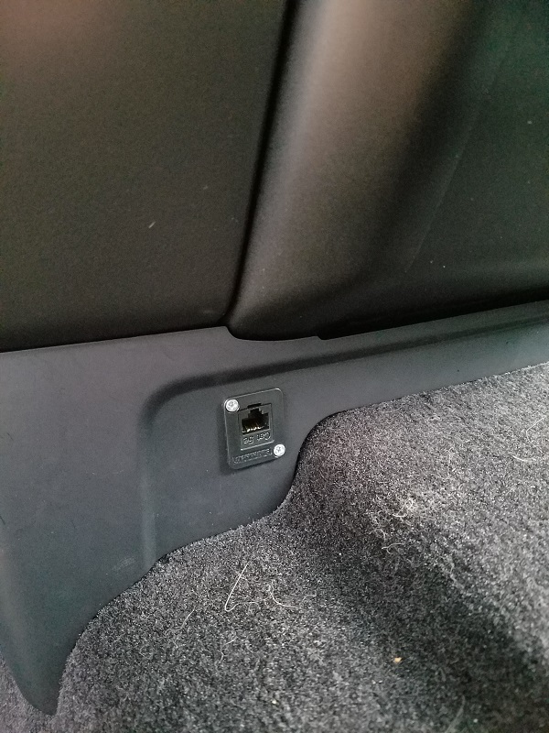
Microphone Connection
RJ45 Panel Mount
Ultimately decided on this panel mount.
Cleaner look.
More reliable.
Does require some fabrication.
Notes:
This is the Switchcraft connector part shown earlier

Slide 41
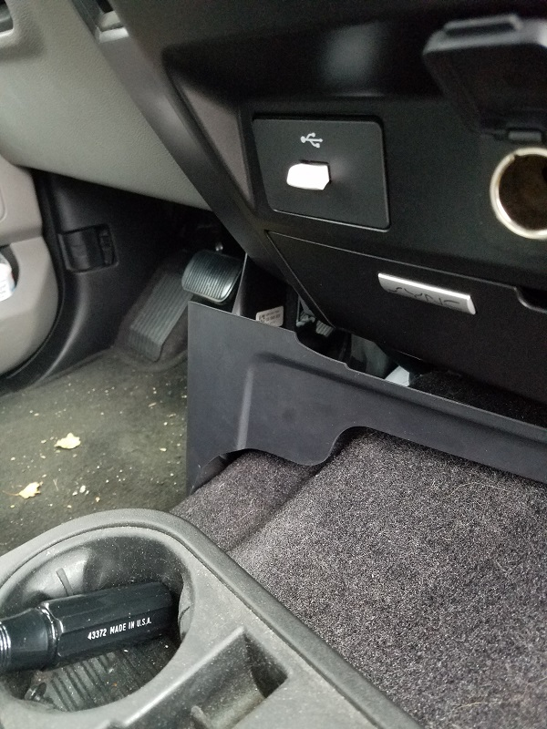
Microphone Connection
RJ45 Panel Mount / Fabrication
Panel removed easily. Held in place with just a couple of screws.

Slide 42
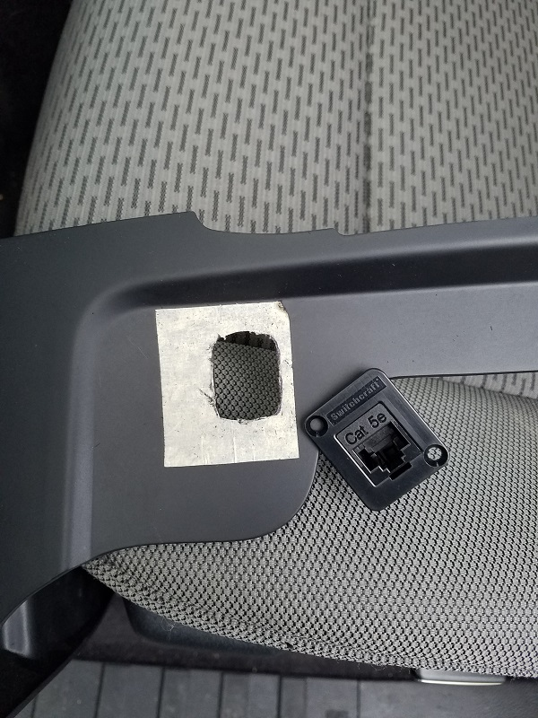
Microphone Connection
RJ45 Panel Mount / Fabrication
Mount location selected and covered with masking tape.
Panel mount inner profile traced onto tape.
Dremel tool used to remove material from panel.
Mounting holes marked, then drilled.
Notes:
Material was easy to remove and control by hand with Dremel tool

Slide 43
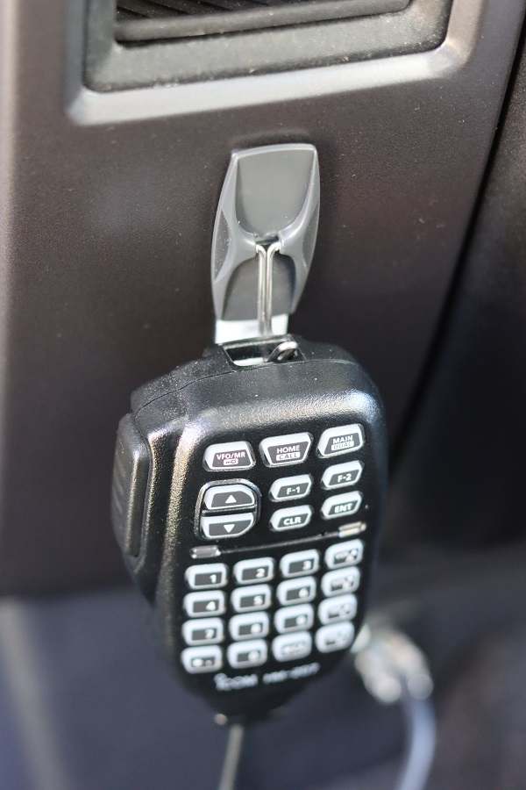
Microphone Connection
Mic. Hanger
3M ‘Command’ hook used to secure Mic.
Said to be ‘damage free’ on removal. We’ll have to see..
No issues so far after > 1yr of use.

Slide 44
Radio Head Mounting Hardware
Notes:
Struggled with various mounting methods
Did not want to do any additional drilling / cutting / or modifications
Cup holder mount..? No. I need all those cup holders.
Flexible rod seat bolt mount..? Would move around too much and get in the way.
What to do..?

Slide 45
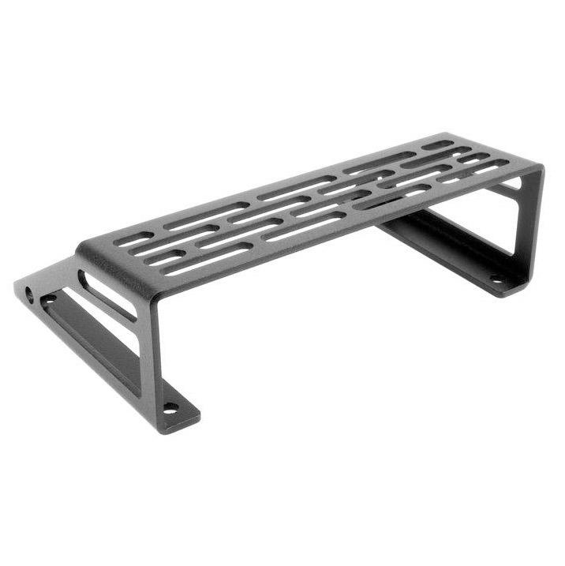
F-150 Dash Mounting Surface
BuiltRightind.com
P/N 104012
Custom made for F-150 top tray.
Mounting Hardware and instructions included.
$45

Slide 46
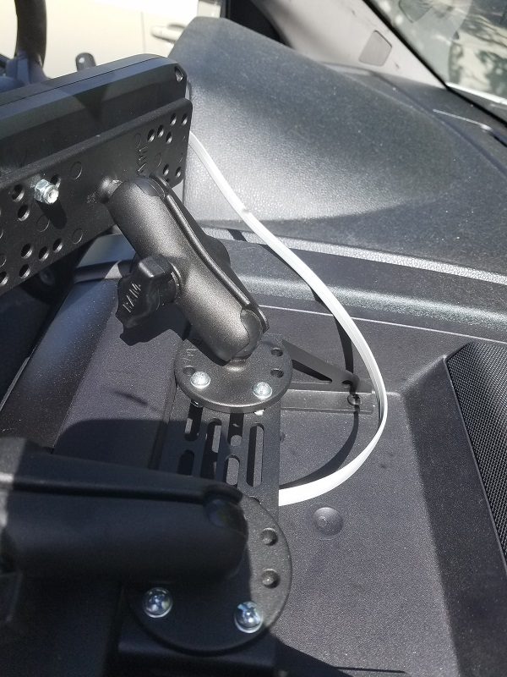
F-150 Dash Mounting Surface
Tray pops out with a few screws and some clips.
Remove tray, mark mount holes and drill.
Mark tray location for control cable. Drill hole just large enough to support a rubber grommet for cable pass-through (not shown).
Pull control cable through grommet, attach mounting plate, and re-install tray.
Notes:
Dash tray comes with a molded rubber base which has been removed (and saved)
If the radio is ever removed, the base can be put back and all holes will be covered.

Slide 47
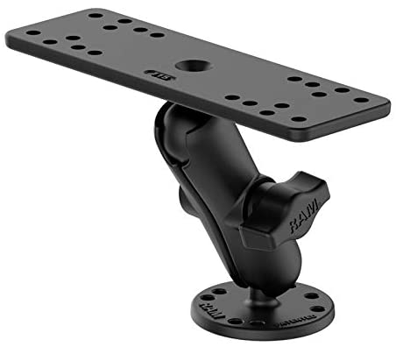
RAM Head Unit Mount
Used to mount the ID-5100 Head Unit to the Dashboard Plate.
P/N RAM-B-111U
$33.49
Amazon

Slide 48
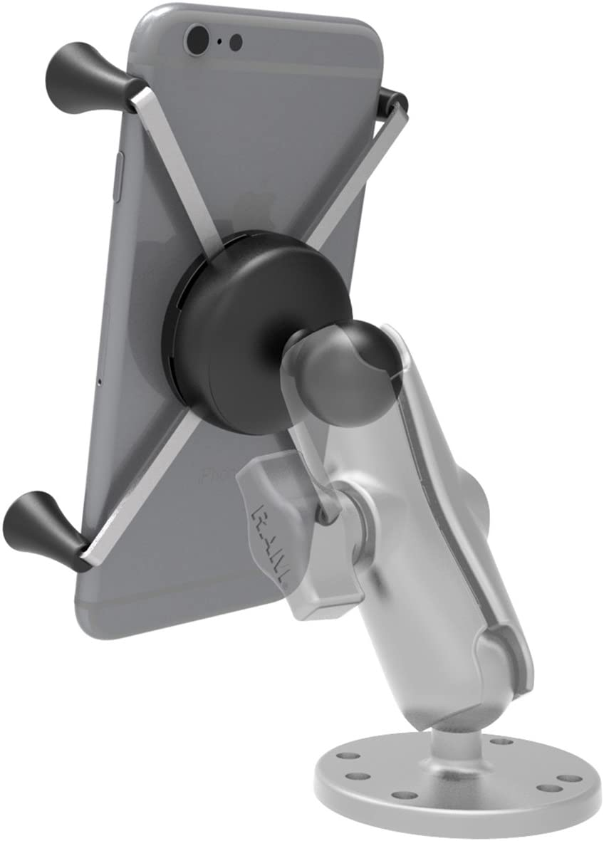
RAM Cell Phone Mount
RAM X-Grip with Ball Mount, P/N RAM-HOL-UN7BU / $29.49
RAM Double Socket Aarm, P/N RAM-B-201U-C / $18.49
RAM Round Plate with Ball, P/N RAM-B-202U / $14.99
$62.97 Total
Notes:
I liked the radio head mount so much I purchased their cell phone mount.
These products are built like tanks and never slip or vibrate.

Slide 49
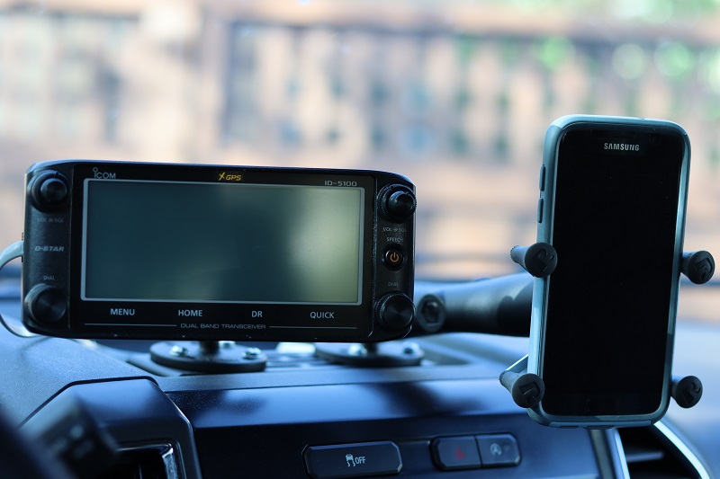
RAM Mounts
Radio and phone are within easy reach.
Both mounts are infinitely adjustable and swappable.
Once adjusted and secured they stay put.

Slide 50
Antenna Selection
My Checklist:
  Dual Band (2m – 440 cm)
  NMO Mount
  Not too long, not too short
Notes:
Better gain with longer antenna.
Always a compromise here. Only wanted one antenna, and not too long.

Slide 51
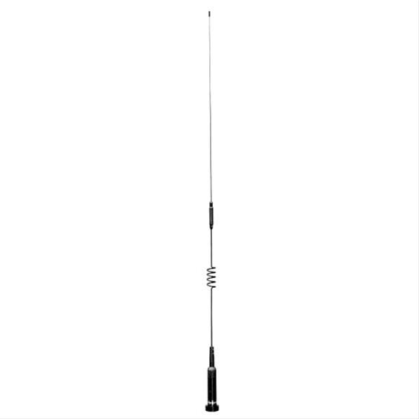
Diamond NR73BNMO
$54.95
Dual Band / 33.5” long
HRO
Notes:
This model was selected and purchased at HRO in Oakland.
Sales person was very helpful and knowledgable.

Slide 52
Antenna Location and Mounting Options
Notes:
This was the hardest part of the whole process
Lots of decisions to make
Temporary vs permanent?
Where to mount?
To drill or not to drill?

Slide 53
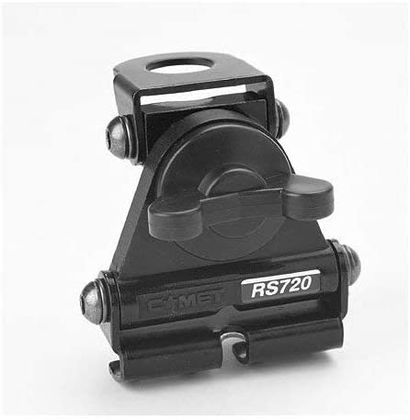
Comet NMO Lip Mount
$35.99
Comet P/N RS-720NMO
Amazon
  Used it for awhile.
  Ok for travel.
  Decided I wanted something more permanent.
Notes:
Got tired of constant setup and take down.
Mount is robust. Never concerned about it coming loose.
Some concern over theft / vandalism

Slide 54
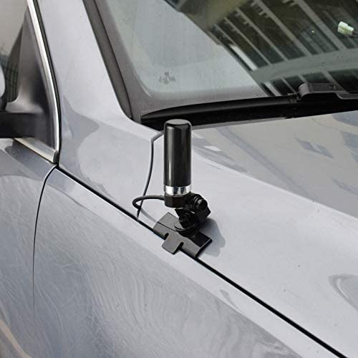
Antenna Location / Edge Mount
Pros:
  Easy to install.
  No drilling / modifications.
  Multiple placement options.
  Easy to remove.
Cons:
  Potential for RFI due to proximity to engine (if mounted like image).
  Skewed radiation pattern.
  Poor grounding.
Notes:
Image pulled from web. Not my setup.

Slide 55
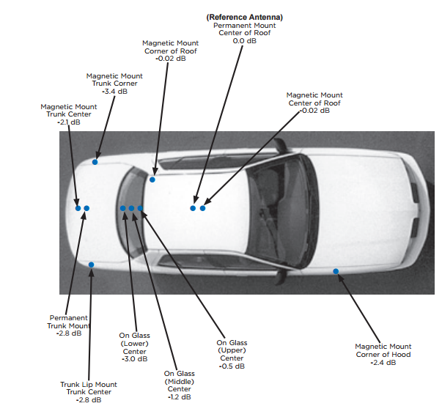
Antenna Location / Performance
Notes:
Center of roof is reference point (0.0 dB)
All other locations are lower in performance anywhere from -0.02 dB to -3.4 dB

Slide 56
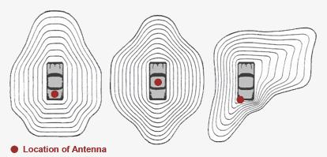
Antenna Location / Radiation Patterns
Notes:
Typical radiation patterns based on location.
After reviewing all this information, I decided to go with center roof mount.
I did not however want to attempt this part of the installation myself.
Started searching for buisinesses that do this sort of thing.

Slide 57
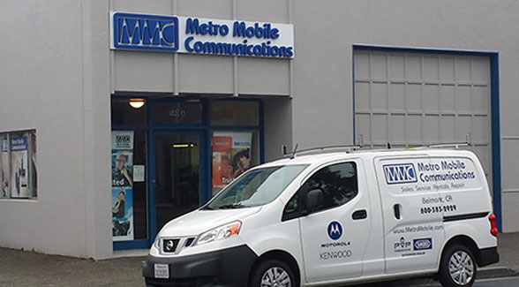
Antenna Installation
Metro Mobile / Burlingame
  Expertise
  They outfit entire city, and county agencies for mobile communications.
  They do small jobs too !
  $217 / Time and Material for my job.
I did not want to attempt myself.
No second chance if you drill the hole wrong.
Notes:
Not many options when looking for a shop to do this kind of work.
Removed headliner
Found suitable location for mount
Drilled, Mounted, and routed coax.
Terminated with PL-239
Performed Cable / Antenna analysis
Put everything back together.

Slide 58
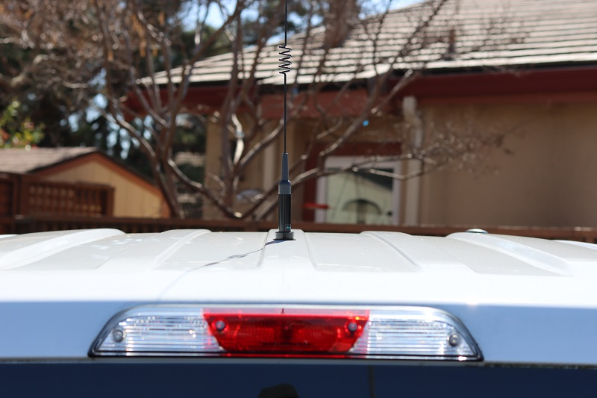
Antenna Installation
Installed at center of rooftop.

Slide 59
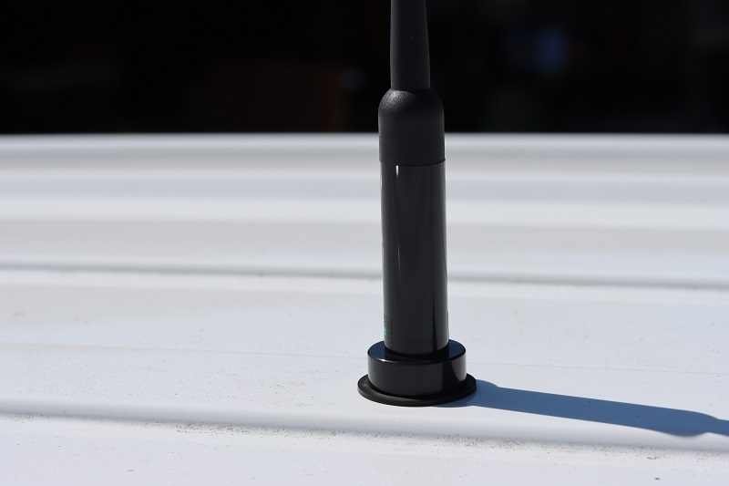
Antenna Installation

Slide 60
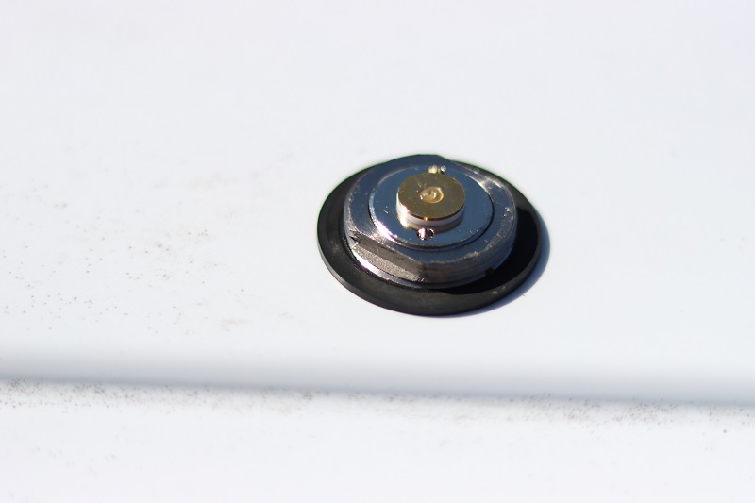
Antenna Installation
Antenna screws onto mount (hand tight) and is sealed by rubber grommet.
Metal threaded cap was provided for when antenna is removed.
Notes:
Don’t forget to remove the antenna when:
At the car wash
Having car serviced
On a night out when your pulling into that parking garage

Slide 61
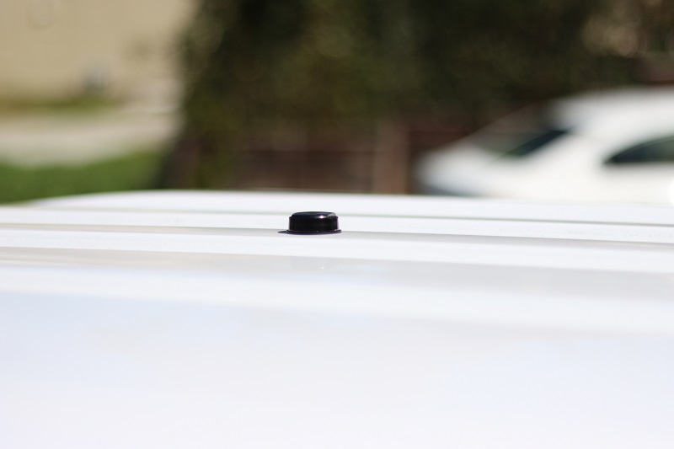
Antenna Installation
Screw on antenna mount cover.

Slide 62

Permatex Dielectric Grease
$4.49
Permatex P/N 81150
Amazon
  Used sparingly on NMO mount threads and center pin.

Slide 63
Mobile Speaker Selection and Location
Notes:
Didn’t think about this too much.
Wanted something small but loud enough for the road
Swivel bracket mount would be a plus

Slide 64

Mobile Speaker
$14.01
RoadPro Model RPSP-15
Amazon
Notes:
Gets me by, but not very loud

Slide 65

Mobile Speaker / Location
Secured below rear passenger seats with Velcro straps.
Out of sight when seats folded down.
Wired to a 3.5mm connector that plugs into back of radio.
Notes:
Decent sound
Not very loud

Slide 66
Final Thoughts
  Do as much research up front. You may find a solution you hadn’t though of.
  Plan how you are going to do it before you start.
  Overall happy with the installation so far
  Could have done better research on mobile speakers
  Need to bolt the speaker to the rear compartment trim
  Need to design an enclosure for the radio and secure it better
  Need to locate a proper grounding point for the radio body
  Need to add a powerpole distribution block for accessories

Slide 67

Questions?

Slide 68
Acknowledgements
Wire Size Selection Guide
  https://www.everythinghamradio.com/2016/09/eth037-we-have-the-power/
Mobile Antenna Placement
  https://kv5r.com/ham-radio/mobile-antenna-placement/
Wiring and Grounding
  http://www.k0bg.com/wiring.html

